Slide 1


Mono Apartments
System Overview Presentation

Slide 2

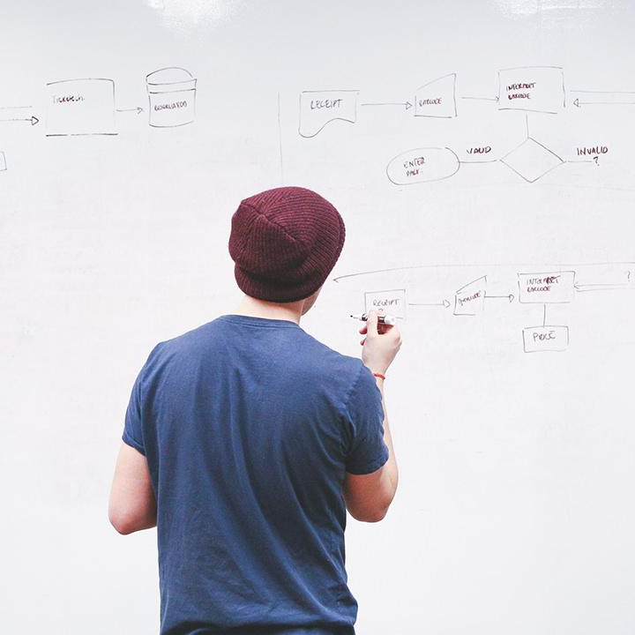
PRESENTATION INTRODUCTION
Meet the Team
Client Brief
System Pitch
Business Process
Our Users
Timeline
Review
HELLO!
Notes:
Dan

Slide 3





MEET THE TEAM
Daniel Phelan Project Coordinator - Business Analyst
Cassandra Tong Client Liaison - Business Analyst
Ricardo Salcedo Software Developer
Allen (Rui Qin) Software Developer
Frank (ShangQian) Software Developer

Slide 4

BRIEF
Apartment inspection/audit process
Currently using google drive for photos
Uses emails to communicate issues
Needs efficient reporting with contractors
Notes:
Dan
After our intial discussions with Yudo we have understood the problem that Mono have brought to our team involves their current process for organising and completing audits for their apartments. Currently you contact the hired contractor who then goes to the apartment and completes the audit sending photos to the Mono admin team to review and sign off. At the moment these photos are kept and reviewed in a google drive, email or similar methods of storing information.
The main issues you would like us to focus on immediately are the managing of photos and descriptions from the contractors that are completing the audit. Hopefully introducing more standardised processes and efficient reporting/inspections. Ill know pass on to Riccardo to discuss the elevator pitch.

Slide 5

ELEVATOR PITCH
Contractor Inspection Form
Upload photos and descriptions
Contacted about issues
Admin Portal
Create, view and manage Inspection Form
Notes:
Ricardo
Our team will be undertaking this project which will assist Mono with their apartment auditing process, the system will allow Mono to create, manage and view inspections that need to be undertaken at their properties. They will be able to send contractors a generated auditing form, with this form the contractor will be able to complete the necessary tasks when conducting their inspection which are mainly photos and descriptions. These will then be sent directly to Mono apartments staff in the form of a PDF which will be accessible through an admin portal. Through this portal the staff will be able to view and manage the information received from the contractors.

Slide 6

BUSINESS PROCESS - ITERATION 1
Managing an inspection booking system
Create and view an Inspection form
Inspection form
View photos and description
Create queries directly to contractor
Notes:
Frank Mono Apartments have requested some key requirements for their desired system.
Priority 1: Managing an inspection booking system of mono apartments properties.
Manage an inspection
Create and view an Inspection form
Inspection form
View photos and description of an inspection.
Create queries for sections of the inspection form, directly to the contractor.

Slide 7
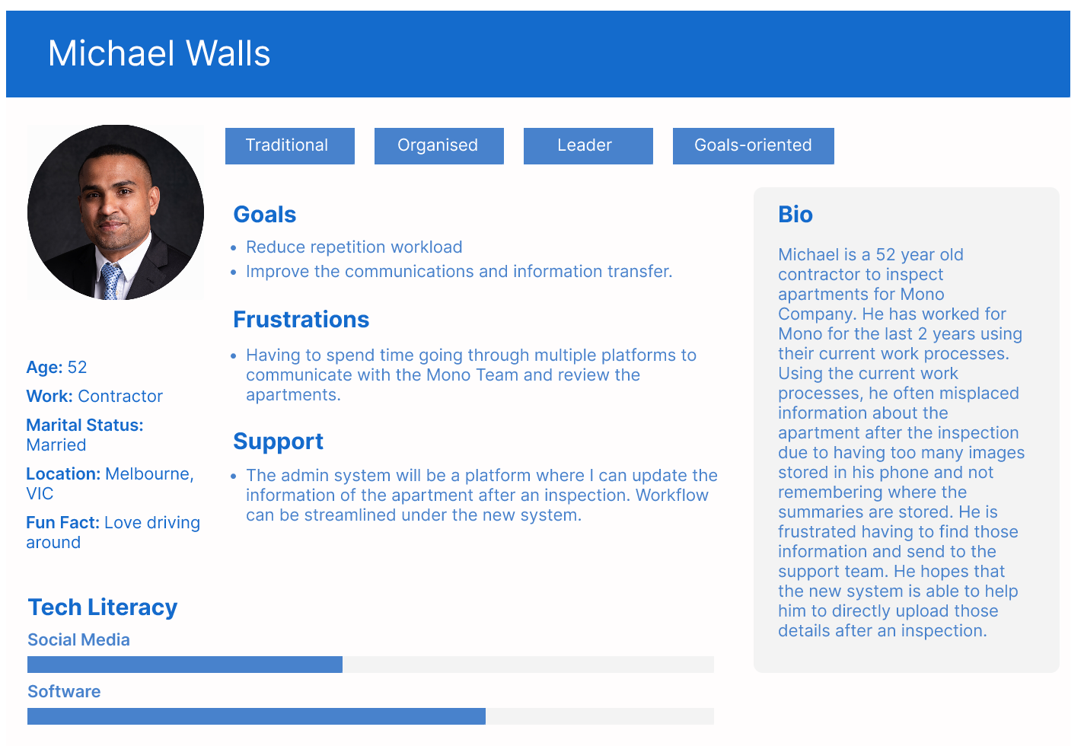
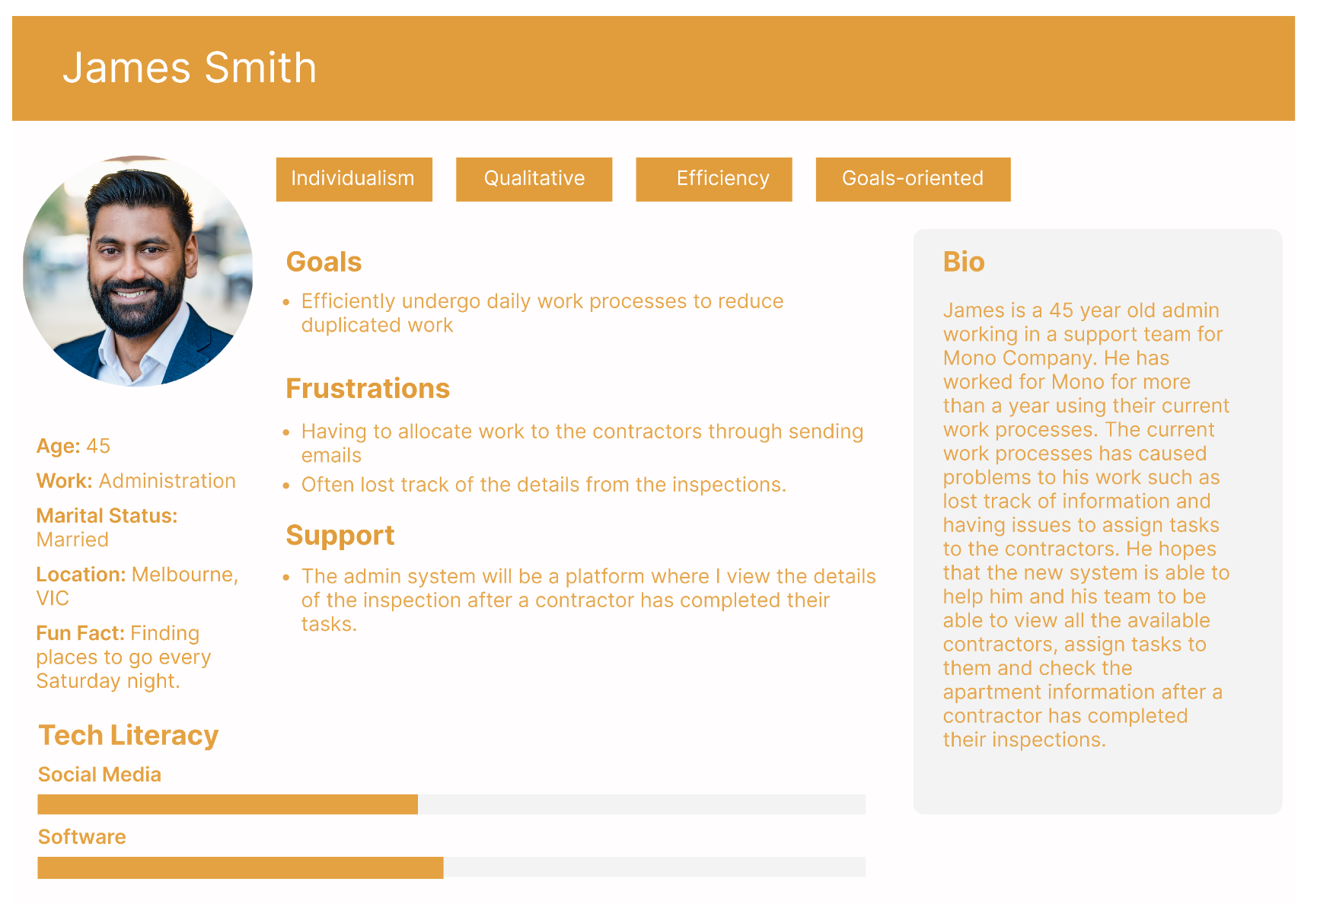
OUR EXPECTED USERS
Notes:
Thank you Frank
In this iteration we will be focusing on our two users Michael as the contractor to inspect the properties and James as the administrator working in the supporting team for Mono.
We have Michael who would prefer working in a streamlined manner for the auditing process on a centralised online system.To reduce his workload to avoid transferring information through multiple online platforms where those information could be lost while being transferred to the supporting team. The system would also allow Michael to upload images and a short summary on the inspection, which is the main intention of this project.
This system would also benefit the supporting team for James to be able to view and manage the updated details from Michael, without having to request Michael to send those information to him, with the new system it would help the team working in an efficient manner, which will avoid waiting period on the contractors responding to James and keeping track of the property information.
Therefore, the new system could enhance a better teamwork in Mono and efficiency. Next, I will pass it to Ricardo to review the timeline on how the project will progress.

Slide 8
PROJECT TIMELINE
Business vision/overview report
Iteration 1 complete with acceptance testing
Iteration 2 report and presentation
Iteration 2 system goes live
System Handover Package
09/03
23/03
06/04
11/05
17/05
Client & Team
Team
Client & Team
Team
Team
Iteration 1
Iteration 2
Deliver
Week 1
Week 6
Week 10
Week 12
09/03
06/04
28/04
15/05
Final build acceptance Testing and Report
Client & Team
Team
Team
Client & Team
Iteration 1 presentation
Iteration 1 system goes live
Iteration 2 complete with acceptance testing
Notes:
Ricardo
I will be going through our project timeline, the length of the entire project spans over 12 weeks during this semester. We start with this overview and presentation which pushes us forward into the start of Iteration 1 where by the 23rd of this month we will have completed our first Iteration. Ready for it to go live by the end of week 6 on the 6th of april. Following on, our next iteration begins on the 6th of april with another presentation similar to this one. After this we have our semester break pushing dates forward by one week. After we return the project continues with iteration 2 which will be the final iteration and will be completed on the 28th of april and going live at the end of week 10 on the 11th of may. Finally we conclude with our final build report and acceptance testing on the 15th of may followed by our complete system handover package and documentation closing out the project on the 17th of may. Thankyou, I will pass it onto Allen to review everything we talked about today.

Slide 9
LET’S REVIEW
Assisting auditing process
Admin portal
Reducing workload
Notes:
Allen
In conclusion, our team will be assisting Mono Apartments with their auditing process by creating a new system. This system will allow Mono to manage inspections and send contractors an inspection form to complete, the form includes necessary tasks such as taking photos and providing descriptions. The information gathered by the contractors will be sent directly to the admin through our admin portal.
The key requirement for the admin portal system is to manage inspection planning, create and view inspection forms, turn the form into PDF and schedule inspections with contractors through an email system.
Overall, our new system will simplify Mono's auditing process and reduce the need for manual communication between admin and contractors, improving the efficiency and accuracy of their operations.
Thank you for ur listening. Do you have any questions or anything would like to add?

Slide 10
THANKS!
Any questions?

